Slide 1
ZEROSuicide Learning Collaborative
Colorado | March 26, 2020

Slide 2
Agenda
Team roll call and verbal check-in
Michael Lott-Manier – CDPHE Office of Suicide Prevention
Suicide prevention related to COVID-19
Michael Lott-Manier – CDPHE OSP
Kim Walton, Clinical Lead – Zero Suicide Institute
Resources
Announcements

Slide 3
Roll Call
For this session we will go back to our verbal roll call - we want to hear from you!
Please check in as we call your organization with your name and a brief check in on your current Covid response plans
Notes:
Remember to also ask here for anyone on the phone but unable to access chat -

Slide 4
Notes:
Explain why I have put this session under lead…………………………….. We are setting the culture.

Slide 5
Polling Question #1
What is your biggest suicide safer care concern related to the current national pandemic?
(Check top two concerns for your organization today)
Staffing concerns
Identification and Suicide screening
Engagement of clients
Collaborative safety planning
Utilization of caring contacts
Care transitions to or from another level of care
Care of staff
Other (write in the chat)
This Photo by Unknown Author is licensed under CC BY

Slide 6
Colorado Update
COVID19.COLORADO.GOV for general state guidance and updates
As of 3/24/20: 912 cases, 35 counties, 84 hospitalized 7,701 people tested, 7 outbreaks at residential and non-hospital health care facilities, 11 deaths
Telehealth guidance for Medicaid from HCPF
APA guidance on telehealth and HIPPA
Counseling on Access to Lethal Means (CALM) training

Slide 7
Care of Staff
Identify current stressors and use team time to openly talk about them
Real people – real life stressors
Use chat to write in the real life stressors that we as mental health professionals are dealing with daily now
How do we as Zero Suicide leaders ensure that we are taking care of our own?
Notes:
Social isolation, kids at home and home schooling, working remotely, financial concerns, anxiety……..
Do we all seriously need our own care plan right now………….

Slide 8
Identification and screening
How do we ensure that all our clients are getting screening at each contact?
What tools are we using and how are we documenting our screening and follow up assessments?
Where and when are we screening?
- special challenges?

Slide 9
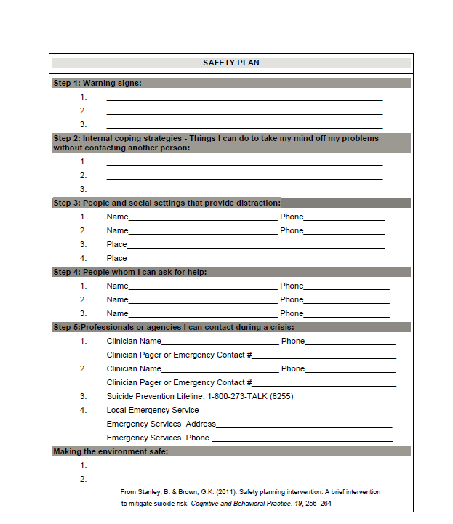
Updates to ALL Collaborative safety plans
Stanley & Brown Safety Planning Intervention
1. Warning signs
2. Internal coping strategies
3. External distraction
4. Personal support
5. Professional support
6. Lethal means safety
Notes:
We, specifically, mean the Safety Planning Intervention. What needs to be different………………….. Unique Covid challenges?

Slide 10
Care Transitions
Focus on those leaving intensive levels of care
Unique challenges now
Suicide care pathway patients
Telehealth in Colorado?
Caring contacts

Slide 11
Caring contacts – Why now?
Who would benefit from caring contacts?
OK – who would NOT benefit from caring contacts???
Unique delivery
Unique messages for today
www.nowmattersnow.org

Slide 12
Questions and Answers………….

Slide 13
Final updates from Michael
Announcements and updates from State
Next meetings:
April 23rd at 10 am
COVID-related discussions as needed
Health equity in suicide prevention
May 28th at 10 am
Veteran suicide prevention: building on lethal means safety
This Photo by Unknown Author is licensed under CC BY-SA

