Slide 1
ZEROSuicide Learning Collaborative
Colorado | January 23, 2020

Slide 2
Agenda
Team Roll Call (please use the chat function)
Michael Lott-Manier and Felice Seigneur– CDPHE Office of Suicide Prevention
Identify Element – Focus on safety assessments
Kim Walton, Clinical Lead – Zero Suicide Institute
Colorado Health Systems Report-Out
Laurie Gerdt – Zero Suicide Faculty
Announcements and Next Steps

Slide 3
Roll Call
New year, revamped Learning Collaborative
Please utilize the CHAT function to let us know you are on the call.
Post your name, any colleagues with you today and your organization
Please welcome Felice Seigneur, CDPHE’s suicide prevention evaluator
Notes:
Remember to also ask here for anyone on the phone but unable to access chat -

Slide 4
Notes:
Identify section – screening and assessment.
Two distinct processes. Screening is not the end.
Also idea of screening people at regular intervals – not just at intake.
Risk formulation (talk about AMSR). Newest thinking around risk – framework says you have to identify people at risk. But we don’t tell you what tools to use. You may want to coordinate and use similar tools.
Who asks, and what’s our relationship, and does it feel safe? Or are we setting it up so we’re going to send them in a police car?
We sent signs to people that we’re receptive to disclosing (body language, how we ask the question) that lead people to not disclose. Have to actually be interested in what they’re going through. Be clear that hospital is only last resort – create expectations of safety.
We can’t wait for the perfect screening method. Have to start now. Change culture.

Slide 5
Polling Question #1
Which of the following screening and assessment tools are you currently using in your organization?
(Check all that apply)
PHQ-9
C-SSRS
ASQ
Stanley Brown Collaborative safety plan
AMSR
CAMS
Other – please write in chat what you are doing

Slide 6
Screening and Assessment
Screen specifically for suicide risk, using a standardized screening tool, in any health care population.
Screening concerns lead to immediate clinical assessment by an appropriately trained, “suicidality savvy” provider.

Slide 7
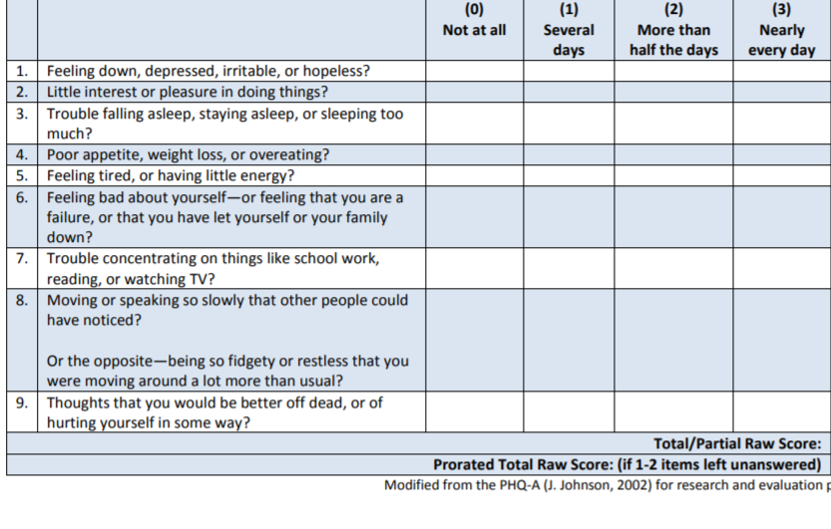
PHQ-9
Source: American Psychiatric Association
Notes:
Two screens that folks typically use:
PHQ-9 and CSSRS

Slide 8
The C-SSRS
Columbia Suicide Severity Rating Scale (Screening Version)
In the past month:
Have you wished you were dead or wished you could go to sleep and not wake up?
Have you actually had any thoughts of killing yourself?
If YES to 2, ask questions 3, 4, 5, and 6. If NO to 2, go directly to question 6.
Have you been thinking about how you might kill yourself?
Have you had these thoughts and had some intention of acting on them?
Have you started to work out or worked out the details of how to kill yourself? Do you intend to carry out this plan?
Have you ever done anything, started to do anything, or prepared to do anything to end your life?
Notes:
Different versions of C-SSRS (adult, adolescent, lifetime – FIND THE OTHERS)
Screening is not sufficient. Screening is standardized – assessment is not. Don’t get caught up in tools. Screening doesn’t and shouldn’t include every question. The assessment is where the nuance comes.

Slide 9
C-SSRS Full Scale For Younger Children A Sample of the Questions
Ask questions 1 and 2. If both are negative, proceed to “Suicidal Behavior” section. If the answer to question 2 is “yes”, ask questions 3, 4 and 5. If the answer to question 1 and/or 2 is “yes”, complete “Intensity of Ideation” section below. | Lifetime: Time He/She Felt Most Suicidal | Past 1 month
1. Wish to be Dead Subject endorses thoughts about a wish to be dead or not alive anymore, or wish to fall asleep and not wake up. Have you thought about being dead or what it would be like to be dead? Have you wished you were dead or wished you could go to sleep and never wake up? Do you ever wish you weren’t alive anymore? If yes, describe: | Yes No □ □ | Yes No □ □
2. Non-Specific Active Suicidal Thoughts General, non-specific thoughts of wanting to end one’s life/die by suicide (e.g., “I’ve thought about killing myself”) without thoughts of ways to kill oneself/associated methods, intent, or plan during the assessment period. Have you thought about doing something to make yourself not alive anymore? Have you had any thoughts about killing yourself? If yes, describe: | Yes No □ □ | Yes No □ □
Source: The Columbia Lighthouse Project http://cssrs.columbia.edu/the-columbia-scale-c-ssrs/cssrs-for-communities-and-healthcare/#filter=.general-use.english
Notes:
Different versions of C-SSRS (adult, adolescent, lifetime – FIND THE OTHERS)
Screening is not sufficient. Screening is standardized – assessment is not. Don’t get caught up in tools. Screening doesn’t and shouldn’t include every question. The assessment is where the nuance comes.

Slide 10
Source: ASQ NIMH Toolkit - https://www.nimh.nih.gov/research/research-conducted-at-nimh/asq-toolkit-materials/asq-tool/screening-tool_155867.pdf

Slide 11
CAMS - Collaborative Assessment and Management of Suicidality
Evidence-based – created by Dr. David Jobes
Provides a therapeutic framework for suicide-specific assessment and treatment
Collaboration is the key – highly interactive assessment process with patient actively engaged in planning own treatment
Goal is to seek patient’s ongoing feedback on what is working for them and what is not.
More than a screening or assessment tool
Leads to individualized treatment interventions

Slide 12
Discussion Question # 1
Answer in the chat or speak up –
What is the hardest part of the safety assessment process for you and your clinicians ?

Slide 13
Colorado Presenters
Questions for health systems (everyone please join in the discussion- this is your space!)
Have CAMS trainings been useful?
Does your system use other safety assessment approaches?
What are your biggest concerns about your current safety assessment approach, and/or your main concerns about making a change as part of Zero Suicide?
Notes:
Intro – There are so many positive things happening in Colorado – we want to have a standing agenda item each month to highlight the exceptional work that you all are doing..

Slide 14
AMSR – Assessing and Managing Suicide Risk
Research-informed suicide risk assessment and risk formulation
Now setting-specific curricula are available
AMSR Outpatient and Outpatient Direct Care
AMSR Inpatient and Inpatient Direct Care
AMSR Substance Use Disorder
Covers core competencies for suicide assessment and risk formulation

Slide 15
Common Dilemmas in Assessing and Managing Suicide Risk
Managing Suicide Risk
Approaching Your Work: Calm and compassion are needed the most and are the hardest to maintain when working with an individual at risk for suicide.
Understanding Suicide: Suicide rates and risk factors in the population are essential to know, but they are hard to apply in a mental health setting.
Gathering Information: Some individuals at risk won’t tell you they are.
Formulating Risk: Clinicians have to make judgment calls about unpredictable outcomes, often with insufficient or contradictory information.
Planning and Responding: The gulf between the offer and the use of safety or treatment options can be wide.

Slide 16
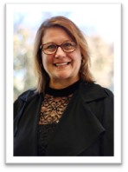
Guest Speaker – Laurie Gerdt
Laurie Gerdt, LMHC
Zero Suicide Faculty

Slide 17
Discussion questions #2
Who are we missing?
Who are we NOT identifying?
Where do we have the greatest gaps in care?
RELATED TOPIC:
How are health systems handling notification processes among health systems, coroner/M.E., others regarding suicide deaths?

Slide 18
Final updates from Michael
Next meetings:
February 27th at 10 am
Focus on Collaborative safety planning
March 26th at 10 am
Focus on special populations – YOUTH

Slide 19
THANK YOU

