Slide 1
Zero Suicide Learning Collaborative December 17, 2020 Please type your name & organization the Zoom chat to sign in!
Notes:
1

Slide 2
Agenda
Community Check-In
Roll call
Holding space for sharing
Model Suicide Care Pathway: Assessment
Planning for 2021
What works / does not work with pathway project
Signing up for future meetings
Looking Forward
Notes:
2

Slide 3
Community Check-In
If you have not already, please use the chat function to sign with your name and organization
Roll call: favorite holiday comfort entertainment (movie, TV show, music, etc.)
Holding space:
End of year reflections
Equity and systems change
Hopes and plans for 2021
Notes:
3

Slide 4
Suicide Care Pathway: Assessment
Screening: standardized tool for asking about suicide risk
Assessment: happens immediately after a positive screen, looks at safety issues, risk/protective factors, determines next steps
Screening
Assessment
Safety Planning
Treatment
Transitions and Follow-Up
IDENTIFY
ENGAGE
TREAT
TRANSITION
IMPROVE
Notes:
4
Hogan served as head of mental health state agencies in Connecticut, New York, and Ohio.

Slide 5
Suicide Care Pathway: Assessment
Which assessment approach does your system use?
Ask Suicide Screening Questions (ASQ)
Collaborative Assessment and Management of Suicidality (CAMS)
Columbia Suicide Severity Rating Scale (CSSRS)
Patient Health Questionnaire (PHQ -#questions)
Suicide Assessment Five-step Evaluation and Triage (SAFE-T)
… Others? Please feel free to speak up or use chat.
What are your biggest challenges with assessment?
Staff feedback/training
Formulating level of risk (low, med., high)
Confidence in using a standard approach vs. intuition
Notes:
5
Hogan served as head of mental health state agencies in Connecticut, New York, and Ohio.

Slide 6
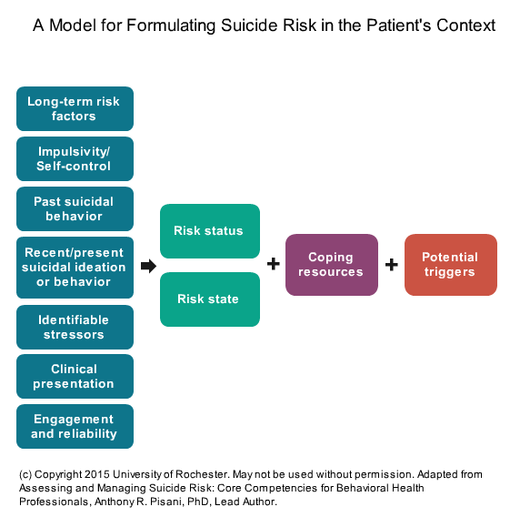
Suicide Care Pathway: Assessment
Zero Suicide Institute:
Risk formulation helps clinicians identify and arrange data to make and document informed decisions. Addresses-
Clinician “judgment calls”
Unpredictable outcomes
Contradictory information
Notes:
6
Hogan served as head of mental health state agencies in Connecticut, New York, and Ohio.

Slide 7
Suicide Care Pathway: Assessment
Discussion questions:
What is missing from the risk formulation approach?
What does your system do well in terms of assessment? Not so well?
Are there any re-frames of assessment that might be helpful?
Risk to safety, assessment to conversation/connection/understanding
Notes:
7
Hogan served as head of mental health state agencies in Connecticut, New York, and Ohio.

Slide 8
Planning for 2021 Monthly Discussions
2021 Date | Topic | Presenter(s)
January 28 | Treat: Using a team approach | Jefferson Center
February 25 | Engage: Safety planning
March 25 | Engage: Care management plans
April 22 | Transition
May 27 | Reviewing elements of the pathway
June 24 | Finalizing group recommendations
July 22 | --
August 26 | --
September 23 | --
October 28 | --
November 18 | --
December 16 | --
Notes:
8
Hogan served as head of mental health state agencies in Connecticut, New York, and Ohio.

Slide 9
Thank you! Next Meeting: January 28, 2021! 10 – 11 am Email any topic suggestions, questions, needs, to Michael.Lott-Manier@state.co.us
Notes:
9

