Slide 1


Zero Suicide Learning Collaborative
November 19, 2020
Please type your name & organization the Zoom chat to sign in!
Notes:
1

Slide 2


Agenda
Community Check-In
  Reflections, news & updates
Collaborative Project: Suicide Care Pathway
  Signing
  Screening and Assessment
  Planning for December and 2021
Looking Forward
Notes:
2

Slide 3

Community Check-In: Use Chat to Sign In
All Health Network
AspenPointe
Aurora Mental Health Center
Axis Health System
Banner Health
Beacon Health Options
Centennial Mental Health
Center for Mental Health
Centura- Mercy
Centura- Penrose
Centura- Porter
Centura- St. Mary-Corwin
Children’s Hospital
Colorado Coalition for the Homeless
Community Reach
Crossroads Turning Point
Denver Health
HCPF
Health One
Health Solutions
Jefferson Center for Mental Health
Mental Health Center of Denver
Mental Health Partners
Mind Springs Health
North Range Behavioral Health
Pagosa Springs Medical
Partners for Children’s Mental Health
Rocky Mountain Crisis Partners
San Juan Basin Public Health
San Luis Valley Behavioral Health
SCL Health- St. Joseph
SCL Health- St. Mary
Signal Behavioral Health
Solvista Health
Southeast Health Group
SummitStone Health Partners
UCHealth- Memorial
UCHealth- Northern Colorado
West Springs Hospital
Notes:
3

Slide 4
Community Check-In: What’s Happening?
Reflections from last month?
  Using systems-centered language
Preparing for a “pandemic winter:” telehealth, caring contacts, other needs
What do we need? / What can we give?
Notes:
4

Slide 5

Zero Suicide Toolkit: Prevention in Indigenous Communities
EDC Resource: “Best and Promising Practices for the Implementation of Zero Suicide in Indian Country”
Problematic language, timing
  More than we can cover
In June, Sade Heart of the Hawk Ali presented about two spirit mental health, suicide:
  “Adding to the challenges of implementing Zero Suicide as a framework in Indian Country are historical, intergenerational, and modern-day trauma and their impact on the health and well-being of Indigenous people.”
Notes:
5
Hogan served as head of mental health state agencies in Connecticut, New York, and Ohio.

Slide 6
Building our Suicide Care Pathway
What tools would have helped you, what do you still need?
Colorado health systems audience
Shared understanding and vision
Screening
Assessment
Safety Planning
Treatment
Transitions and Follow-Up
IDENTIFY
ENGAGE
TREAT
TRANSITION
IMPROVE
Notes:
6
Hogan served as head of mental health state agencies in Connecticut, New York, and Ohio.

Slide 7
Identify: Screening for Suicide
Screening
Clinical tools
Health system policies
Staff training and guidance
Others?
Screening vs. Assessment
Screening comes first, can prompt next steps
Universal initial information gathering
Involves non-clinical staff, broader system
Screening as Policy and Practice
More than just a questionnaire
Helps define terms and responsibilities
Initiates and organizes crucial services
Shapes health system culture and performance
Notes:
7
Hogan served as head of mental health state agencies in Connecticut, New York, and Ohio.

Slide 8
Polling Time: Screening Tools
What screening tool does your health system use to identify people who are at risk of suicide?
Ask Suicide-Screening Questions (ASQ)
Columbia Suicide Severity Rating Scale (C-SSRS)
Patient Health Questionnaire 9 (PHQ-9)
Patient Safety Screener (PSS-3)
Suicide Assessment Five-step Evaluation and Triage (SAFE-T)
Other? (Please share using chat)
Notes:
8
Hogan served as head of mental health state agencies in Connecticut, New York, and Ohio.

Slide 9
Popular Screening Tools
Patient Health Questionnaire 9 (PHQ-9)
  Brief series of scale questions to gauge depression symptoms over last two weeks
Columbia Suicide Severity Rating Scale (C-SSRS)
  Plain language questions about suicidal ideation and behaviors over lifetime or recently
What does your system use, and why?
  Choosing the right tools for setting, population
  Different tools used within same system?
Challenges or successes with certain tools
  C-SSRS has become a standard- thoughts? PHQ-9 v. C-SSRS?
  Any new or specialized screening tools to share?
Notes:
9
Hogan served as head of mental health state agencies in Connecticut, New York, and Ohio.

Slide 10
Building our Suicide Care Pathway
Screening
Clinical tools
Health system policies
Staff training and guidance
Electronic Health Records
What type of content would be most helpful to share with other health systems?
Focus on actual screening methods or organizational planning
Other considerations
  Level of detail and specificity
  “Health system” can be a hospital, mental health center, substance use clinic, etc.
  Balancing usefulness for our monthly call participants and wider audience
Notes:
10
Hogan served as head of mental health state agencies in Connecticut, New York, and Ohio.

Slide 11
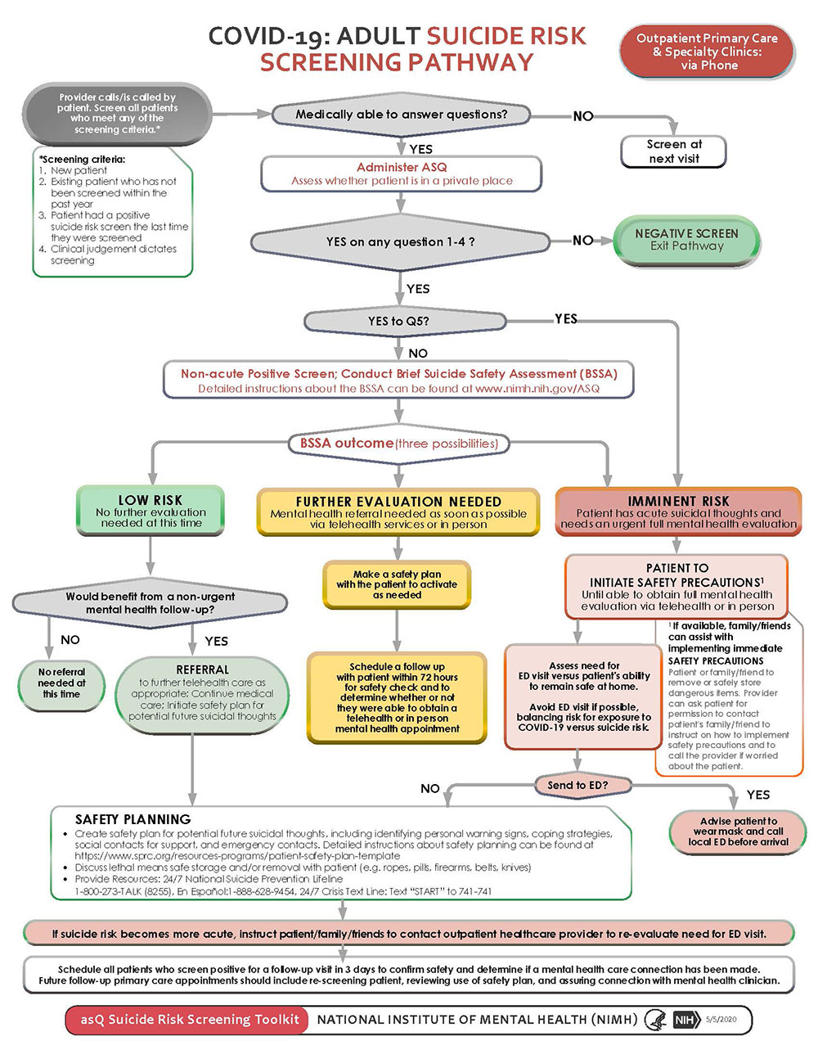
Example: NIMH Screening Pathway Diagram
Notes:
11
Hogan served as head of mental health state agencies in Connecticut, New York, and Ohio.

Slide 12

Example: JCMH Zero Suicide Pathway
Notes:
12
Hogan served as head of mental health state agencies in Connecticut, New York, and Ohio.

Slide 13
Group Discussion
What should the screening element look like?
How can we use the pathway screening recommendations to promote health equity?
Who or what are we missing from this picture?
Notes:
13
Hogan served as head of mental health state agencies in Connecticut, New York, and Ohio.

Slide 14

Thank you!
Next Meeting:
December 17, 2020, 10 – 11 am
Email any topic suggestions, questions, needs, to
Michael.Lott-Manier@state.co.us
Notes:
14

